Slide 1
Budweiser Exploratory Data Analysis
Presented by FoamFingerMakers

Slide 2
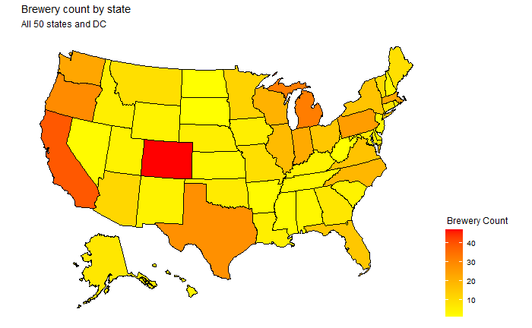
Brewery distribution in the United States

Slide 3
Data Clean Up
Removed 1,007 observations from the data due to missing values in:
ABV
IBU
Style
Remaining data set, 1,403 observations, is adequate for analysis.

Slide 4
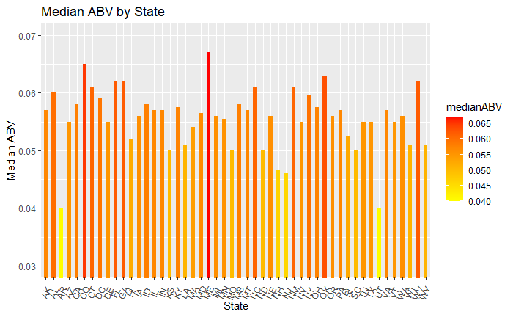
Median ABV for each State
Highest ABV Beer:
Where: Louisville, KY
Brewer: Against the Grain Brewery
Name: London Balling
ABV: 12.5%

Slide 5
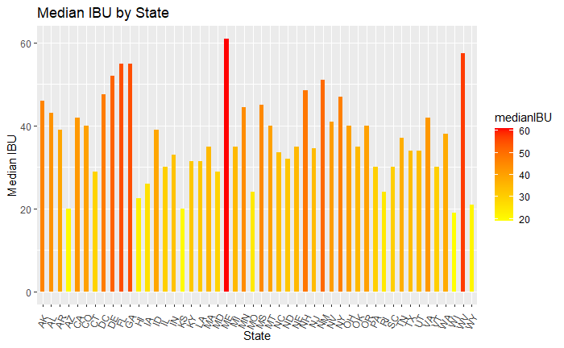
Median IBU for each State
Most Bitter Beer:
Where: Astoria, OR
Brewer: Astoria Brewing Company
Name: Bitter Bitch Imperial IPA
IBU: 138

Slide 6
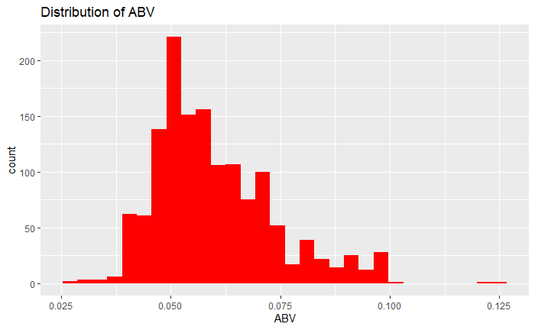
ABV: Summary Statistics and Distribution
Summary Statistics:
Mean: .060
Median: .057
Standard Deviation: .014
Max: .125
Min: .027
Comments:
ABV distribution has a slight right skew and a low spread

Slide 7
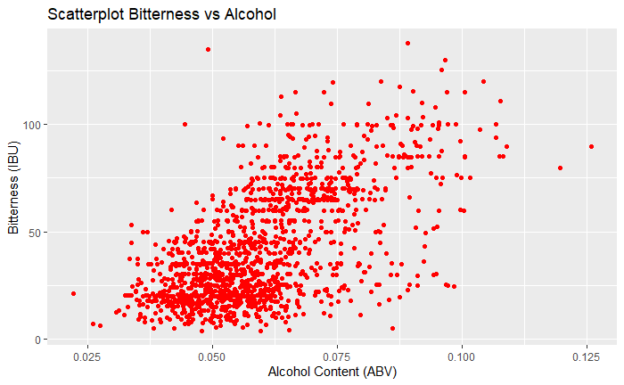
Relationship: Bitterness vs Alcohol
Comments:
Appears to be a positive linear relationship between Bitterness and Alcohol Content. As the ABV increases, the IBU increases.

